Slide 1
Exploration of Dynamic Graph Properties
Wanhao Zhou, Harshil Bhojwani, Longchun Ma, Zhiyuan Shao, Kaiwen Shao

Slide 2
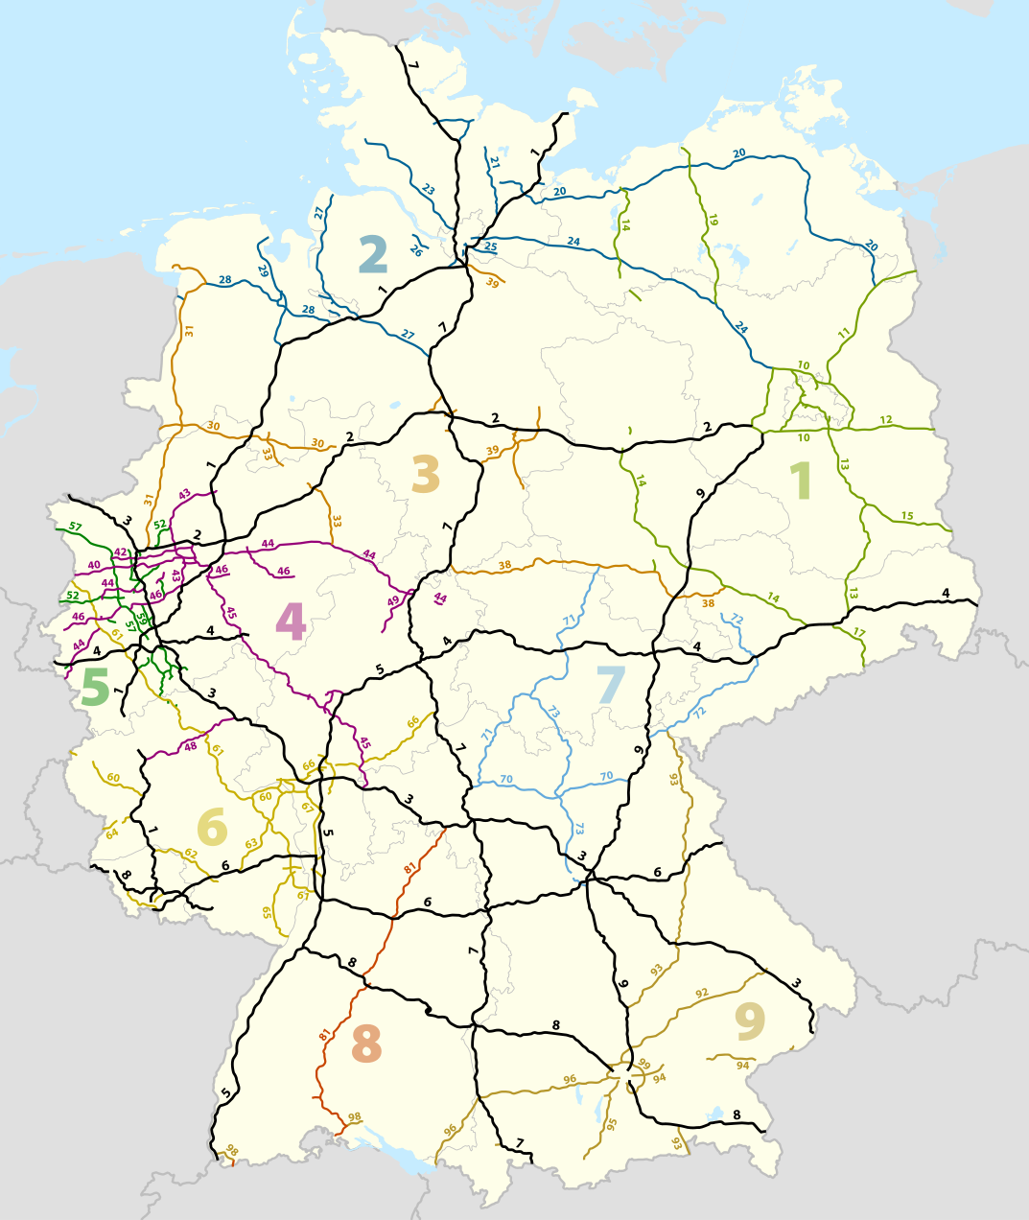
Introduction: Background
Numerous challenges in the real world can fundamentally be seen as graph-related issues.
As urbanization progresses, governments undertake the construction of highways that link cities together, including some cities that previously lacked direct access to each other.

Slide 3
Introduction: Problem
An immediate question that surfaces with the construction of these highways is how it affects the proximities between cities and the best methodologies to model such changes.
This scenario is particularly fascinating to us because it involves the exploration of a dynamic graph structure, where new edges, representing highways, continuously appear over time.
Notes:
(This problem can be modeled as a dynamic graph, where vertices represent cities, and edges represent the highways or roads connecting them. Initially, the graph may have a limited number of edges, reflecting the existing transportation network. As new highways are constructed over 1 time, new edges must be incorporated into the graph, dynamically altering its topology.)

Slide 4
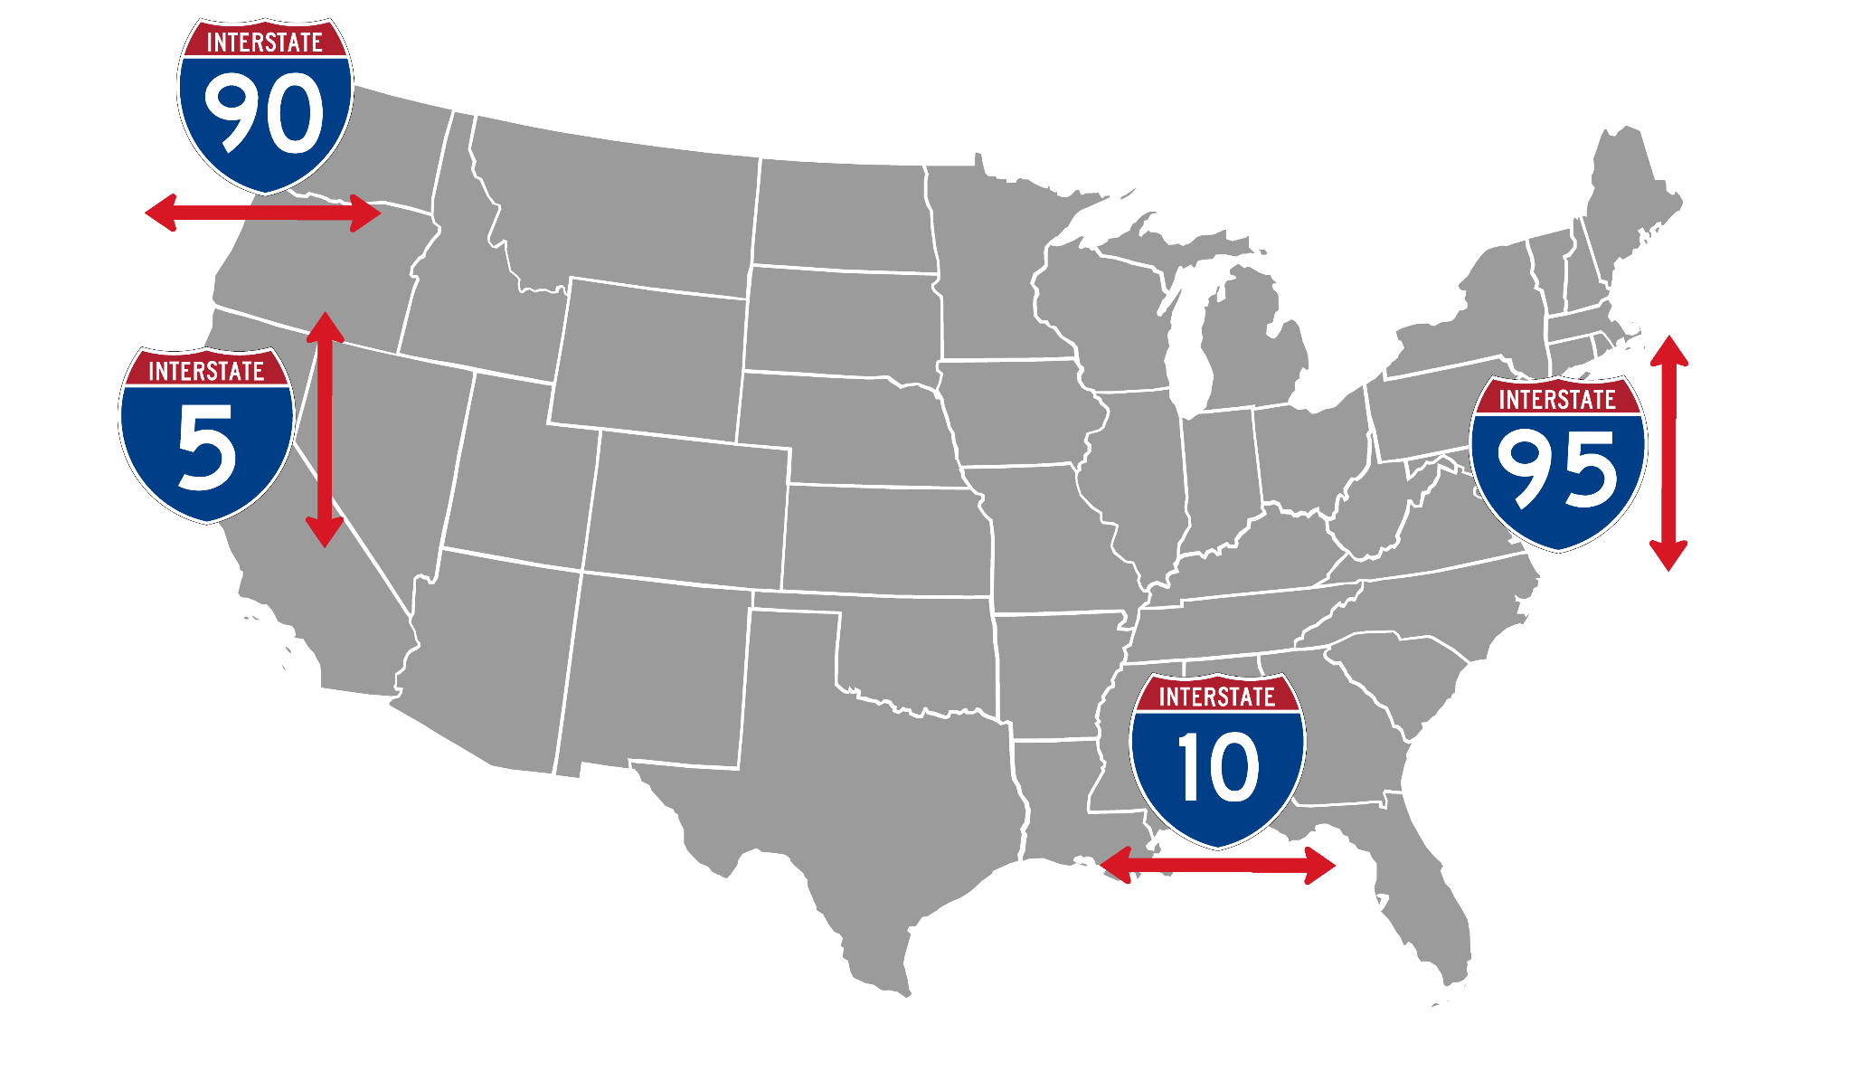
Dataset: The Interstate Freeway
This dataset encompasses the key urban centers interconnected by the primary Interstate Highways of the United States. These routes are traditionally numbered with one- or two-digit identifiers.
Notes:
The map highlights significant Interstate routes and indicates the major cities along these highways, focusing on potential areas for network optimization.

Slide 5
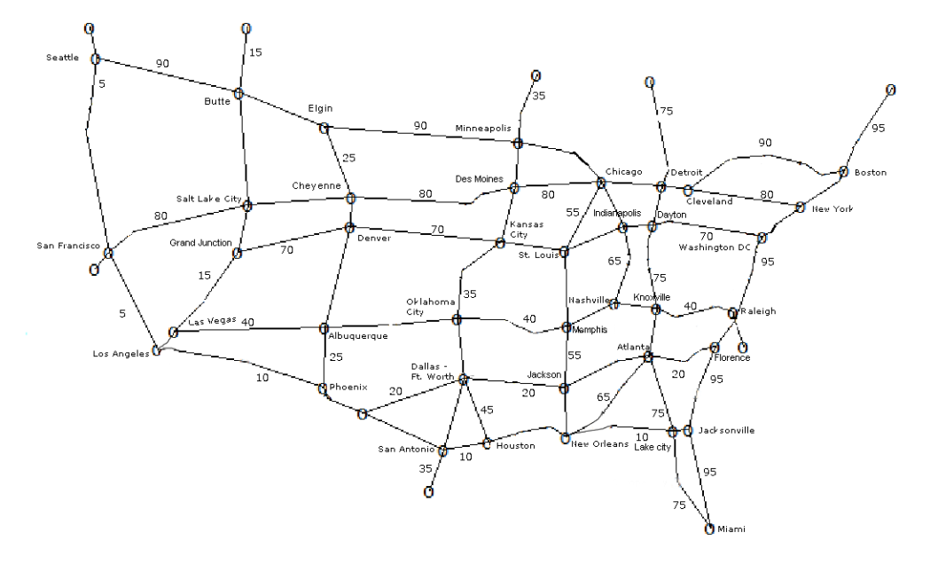
Dataset: Freeway and City
The map shows only the interstates as edges from 5 – 95 that are divisible by 5. And the vertices shown upon the edges are the major cities of America which generally have the biggest population. And the weight(distance) and construction year of each independent edge is stored in edge data.
Notes:
The map provides a visual representation of primary Interstate routes.
Major cities served by these highways are pinpointed to emphasize their roles as nodes within this expansive transportation network.

Slide 6
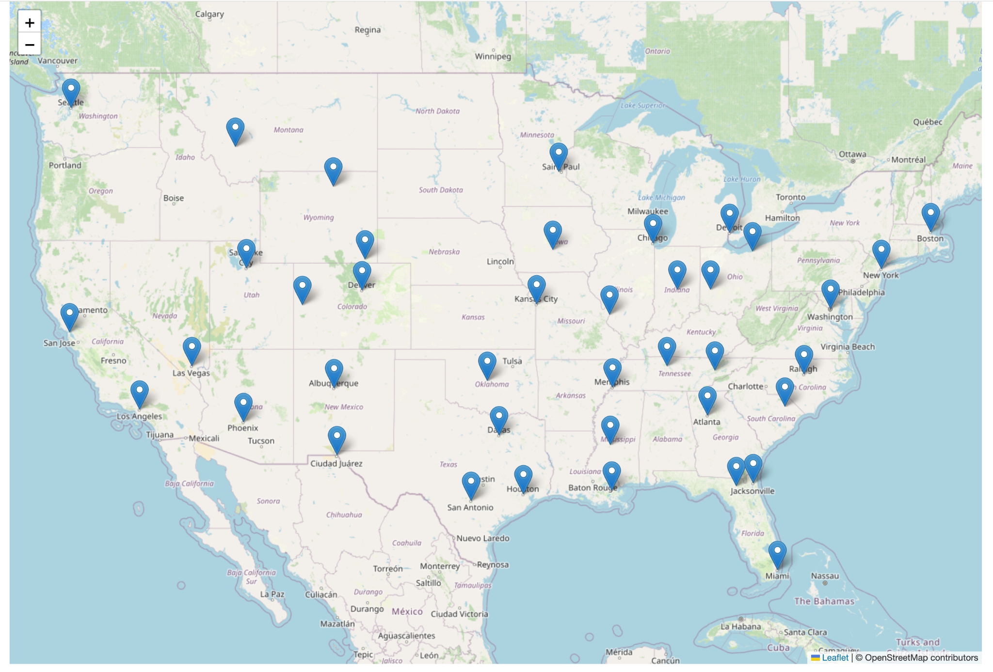
Network Evolution Visualization
We created an animation to show how our graph evolves with time.
In the end, the graph has 40 vertices and 69 edges.
Link

Slide 7
Problem Definition
At a certain time t of construction, we need to either update G or answer the following queries.
Update
Add an undirected edge (u, v) with weight w.
Query
What is the shortest distance for two arbitrary vertices u and v?
If the graph is not connected,
suppose we add an edge (u, v), how does it change the connectivity of the graph?
If the graph is connected,
suppose we add an edge (u, v) with weight w, how does it change all-pairs shortest paths?
can we find bridges in G?
Notes:
We have a graph G of V vertices. Initially, the graph does not have any edges.
We are given a stream of events sorted in time.

Slide 8
Problem 1: Update Graph and Find Shortest Distance
Considering the evolution of the graph, how can we efficiently update and calculate the shortest distance?

Slide 9
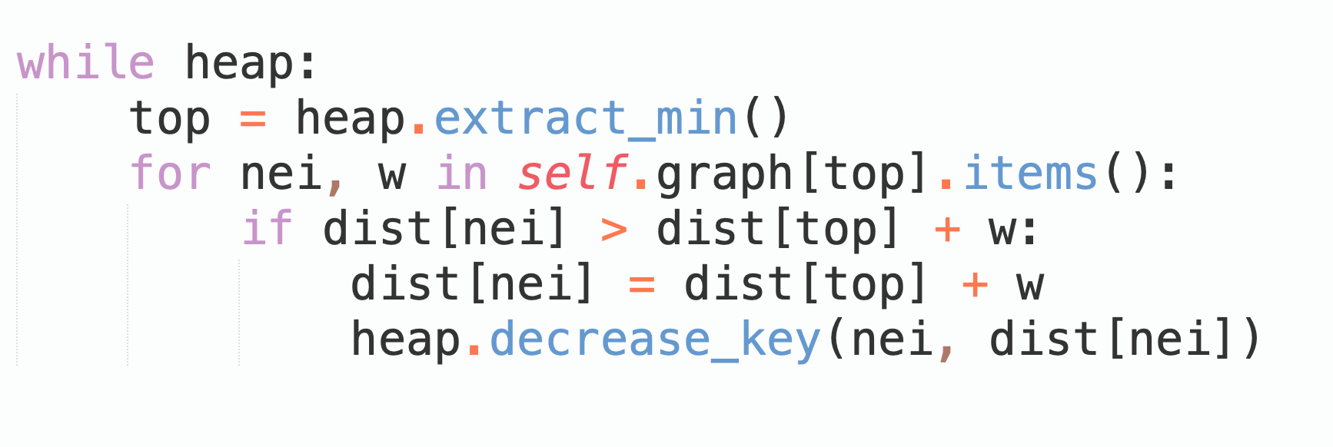
Solution 1.1: Single-Source Shortest Path
Add Edge
We can simply add the edge in the adjacency list of G that runs in O(1).
Find Shortest Distance
We can run a Dijkstra Algorithm that runs in O(E logV) with a binary heap.
In our implementation, we explored the indexed priority queue, where we can decrease the value of a node in the heap in O(logV).

Slide 10
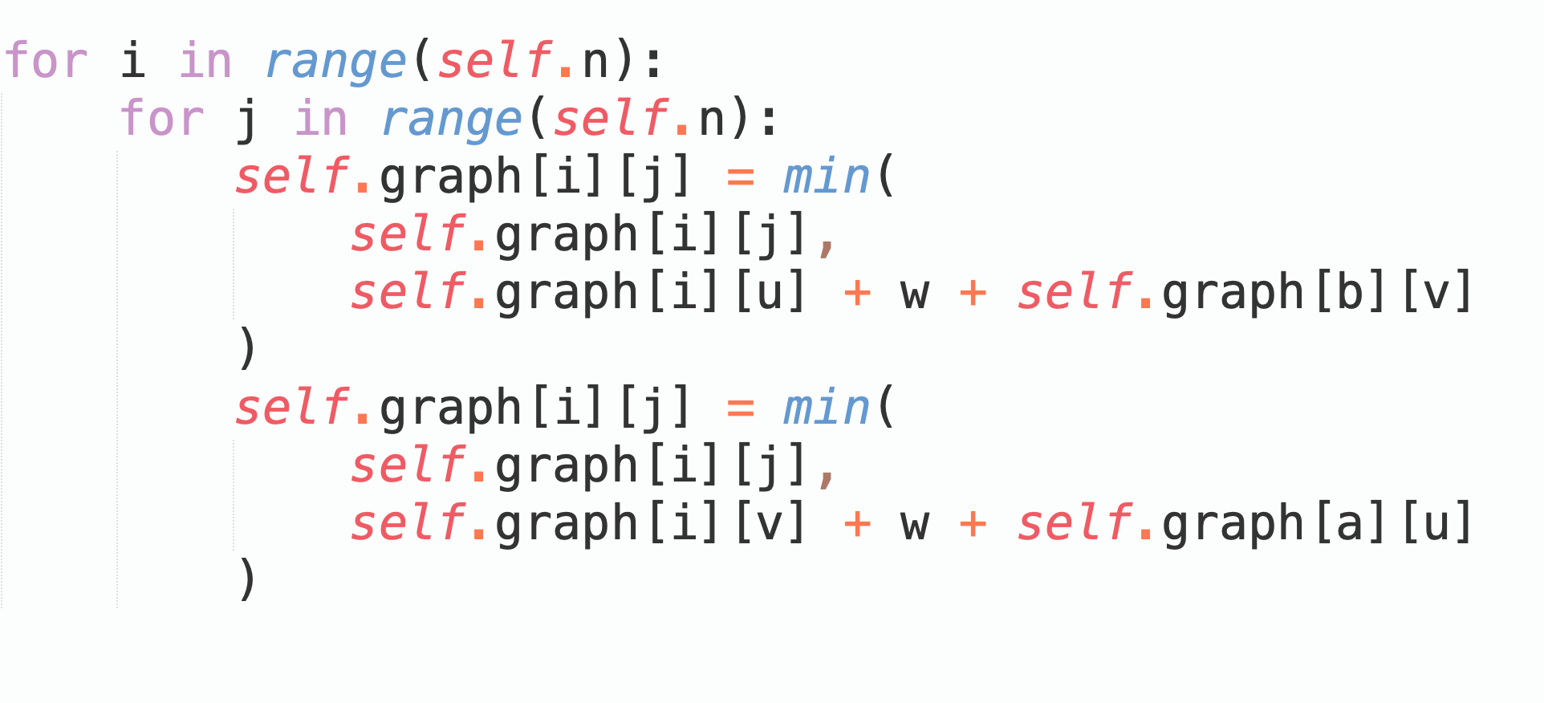
Solution 1.2: Variant of Floyd-Warshall
Though Dijkstra is efficient but implementing it every time for shortest path query is costly therefore another approach is to calculate shortest distance for every pair, in which an Algorithm Floyd Warshall comes in handy.
Add Edge
When adding an edge, try to relax the shortest distance of all pairs of vertices in G
O(V · V).
Find Shortest Distance
For each query, we return the result directly.
O(1).

Slide 11
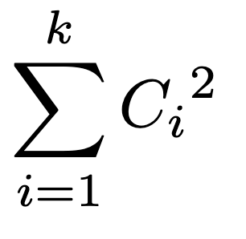
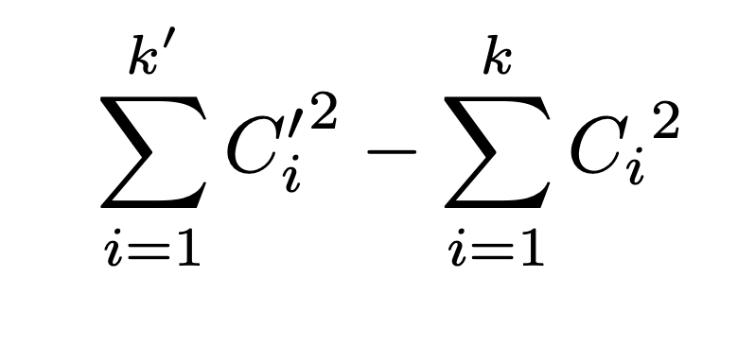
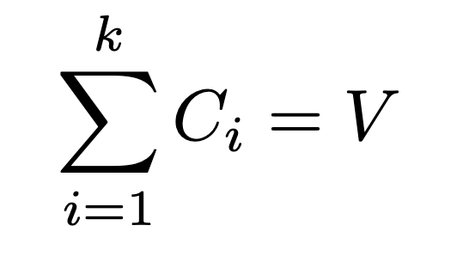
Problem 2: Connectivity
For the current graph, suppose we have k components, each with size C_{i} .
Define the connectivity metric as the sum of square of component size:
When introducing an new edge, compare the metric in the new graph with the old
one:
Since the objective is maximized when there is only one
component, i.e., a connected graph.
Notes:
There is another question here about how newly added edge will connect cites that used to be unconnected. Define connection number as the sum of connected pairs of vertices. We can calculate this number before and after the edge adding.

Slide 12
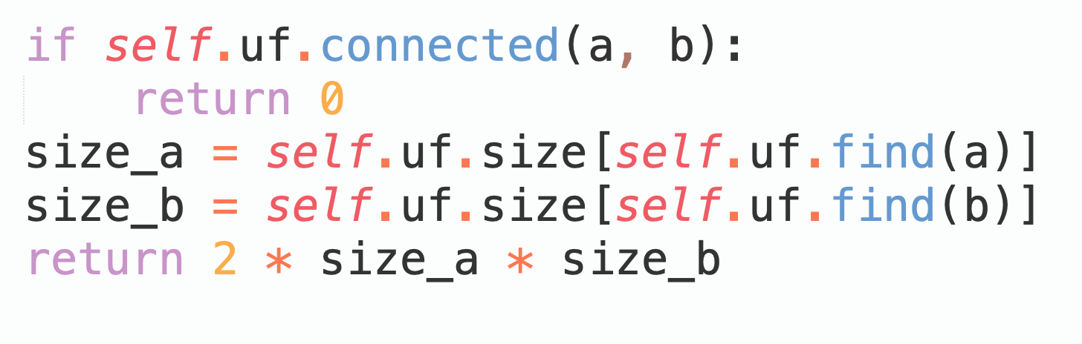
Solution 2: Connectivity
If we are connecting two components of size C_{a} and C_{b} , the difference is 2 · C_{a} · C_{b}.
We can utilize a Union-Find data structure that maintains the size of the component to calculate the value.
The procedure runs in nearly O(1).

Slide 13
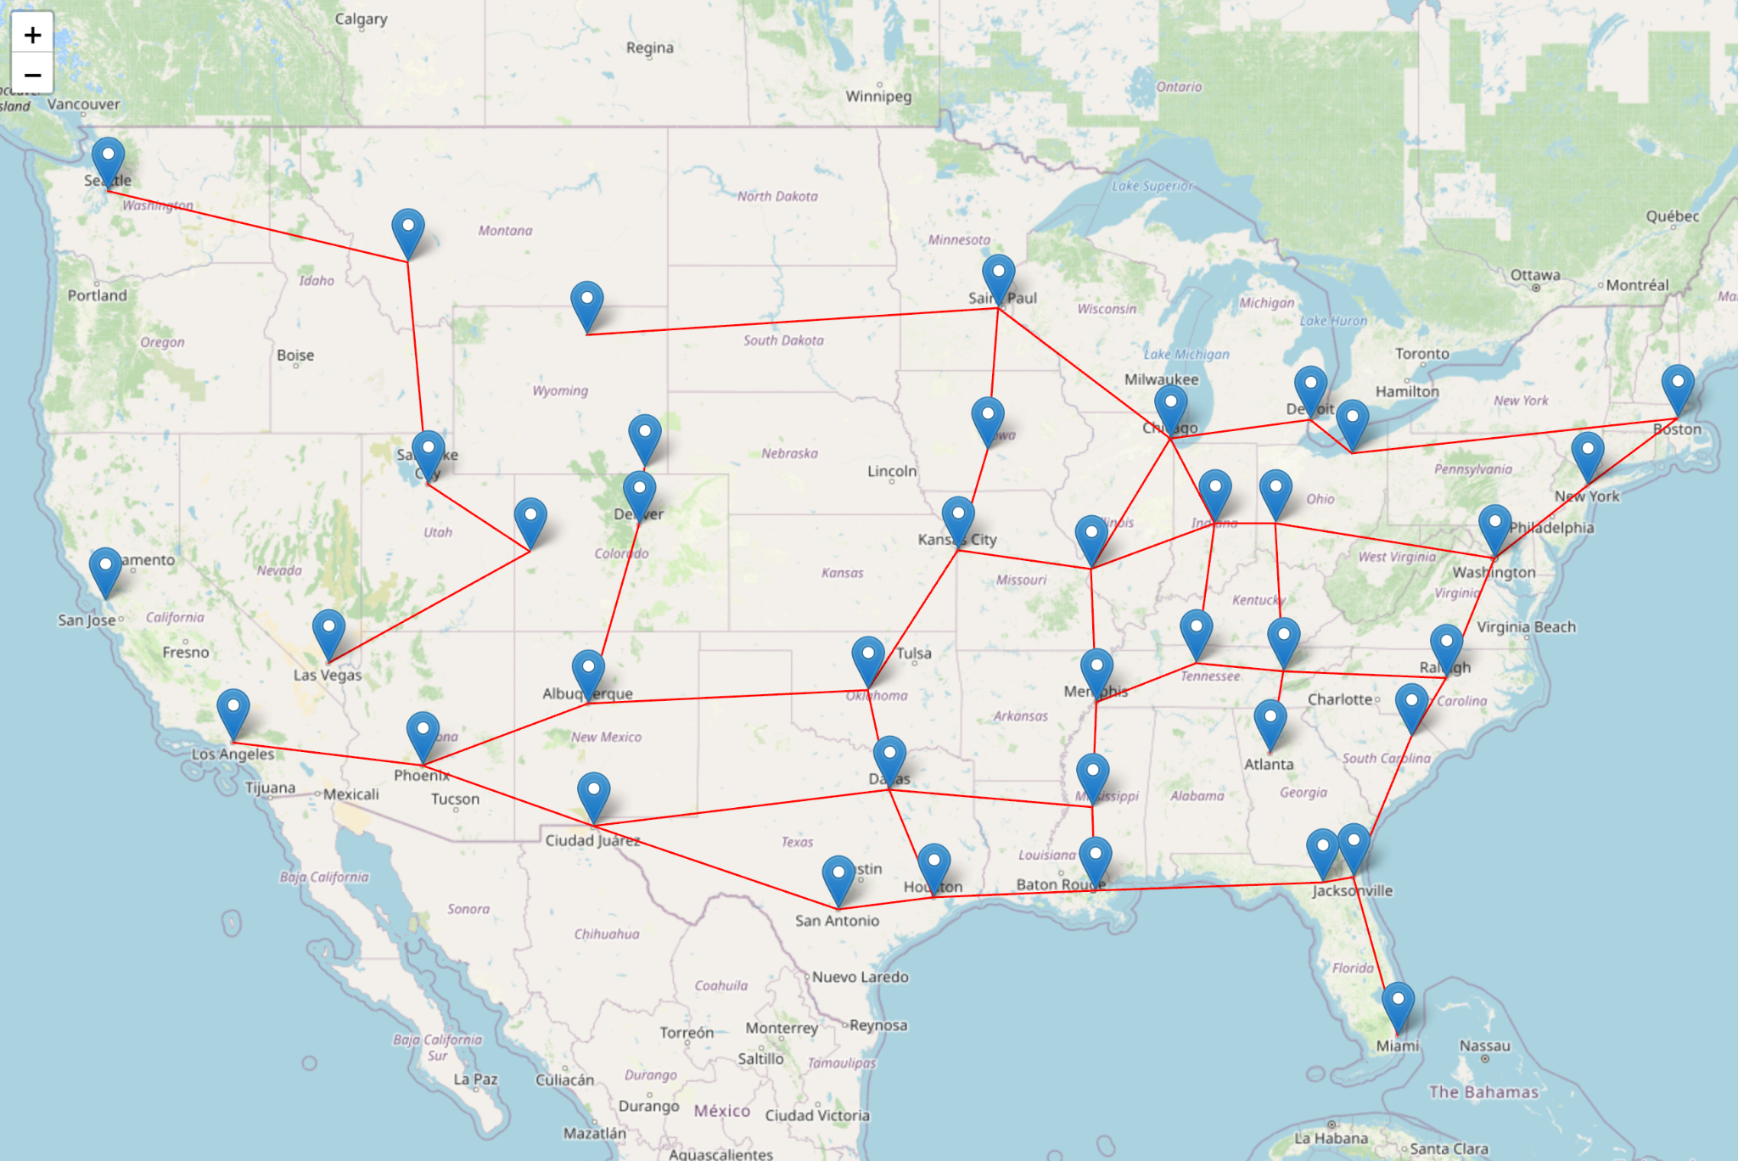
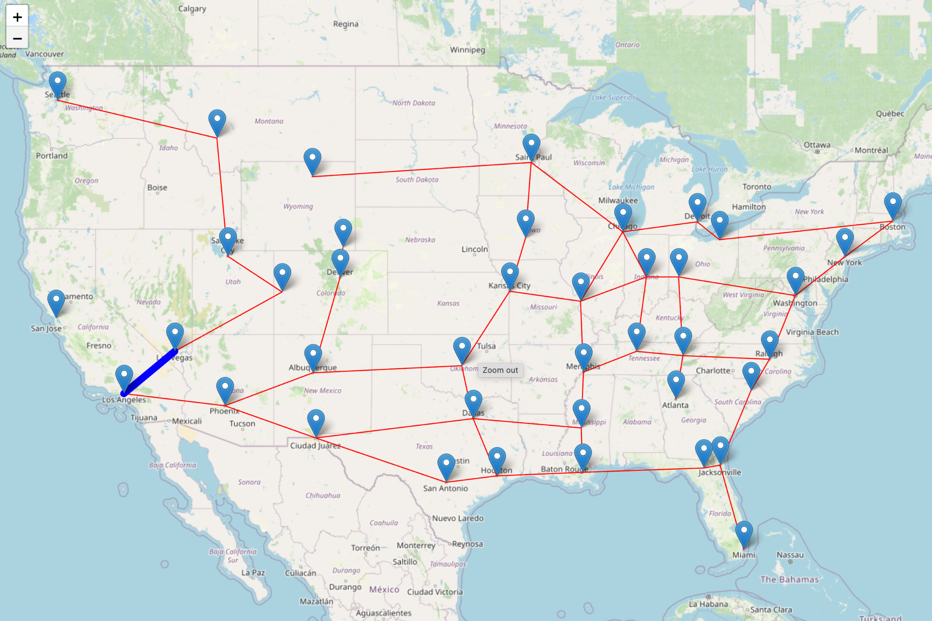
Example 2: Connectivity
In year 1974, connecting Las Vegas to Los Angeles with I-15 increases the connectivity most.
Component A Size = 5, Component B Size = 34. Bring 340 connecting pairs into the graph.

Slide 14
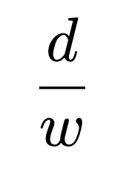
Problem 3: Weighted All-Pairs Shortest Paths
When introducing an new edge, it is likely that the all-pairs shortest paths of G decrease.
We calculate the difference of all-pairs shortest paths d.
In addition, we are interested in the for en edge of weight w, the unit change in
all-pairs shortest paths:

Slide 15
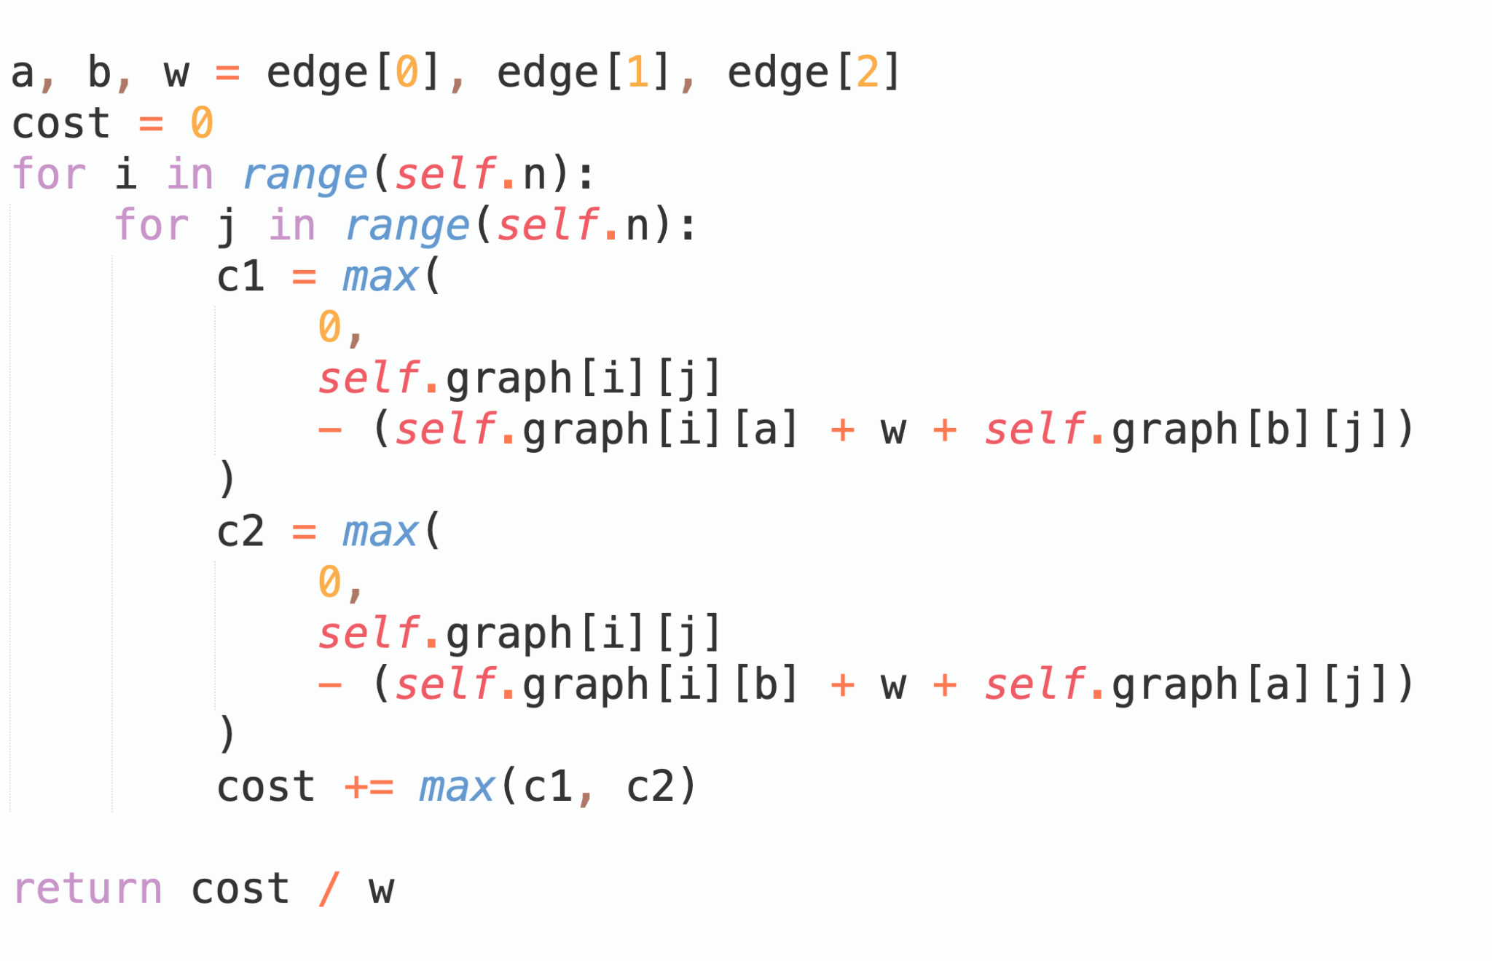
Solution 3: Floyd, again
Similar to Solution 1.2, we can utilize Floyd to calculate the decrease of the distance that runs in O(V · V).

Slide 16
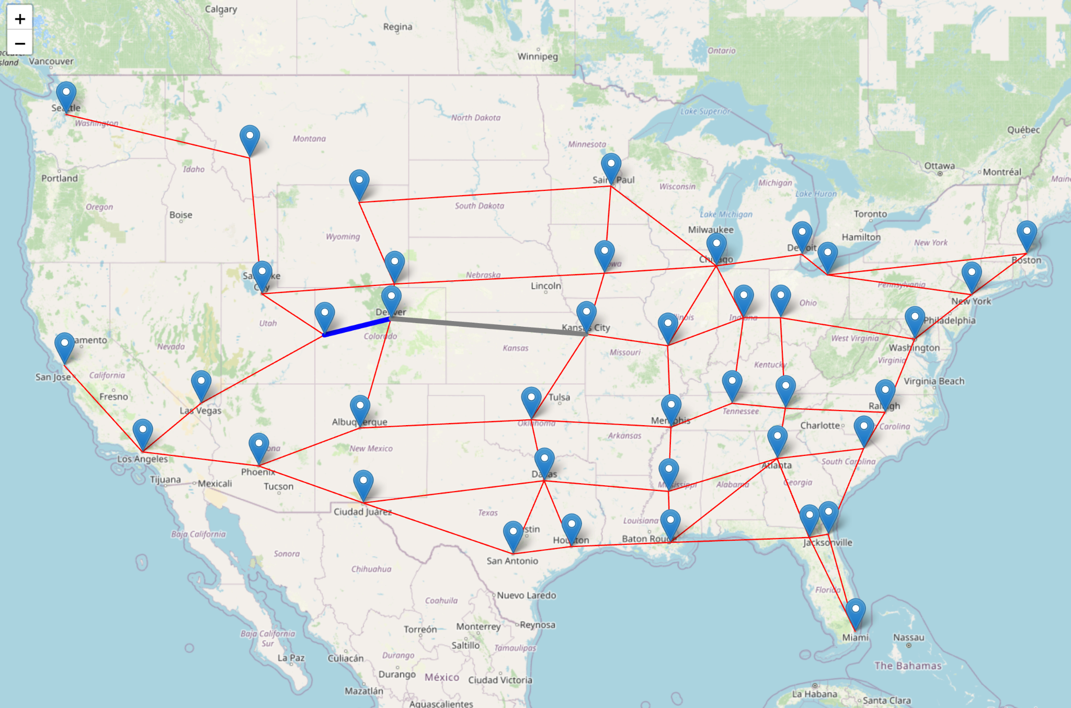
Example 3: Weighted All-Pairs Shortest Path
Suppose in 1992, we need to choose one road between blue (Denver - Great Junction) and grey (Denver - Kansas City).
It turns out that the blue one is more cost efficient, because it reduces more total all-pairs shortest paths (d), and its weight (w) is relatively small.

Slide 17
Problem 4: Bridges
Bridge is an edge of a graph whose deletion increases the graph's number of connected components.
We assume that bridges are critical to the connectivity of the graph.

Slide 18
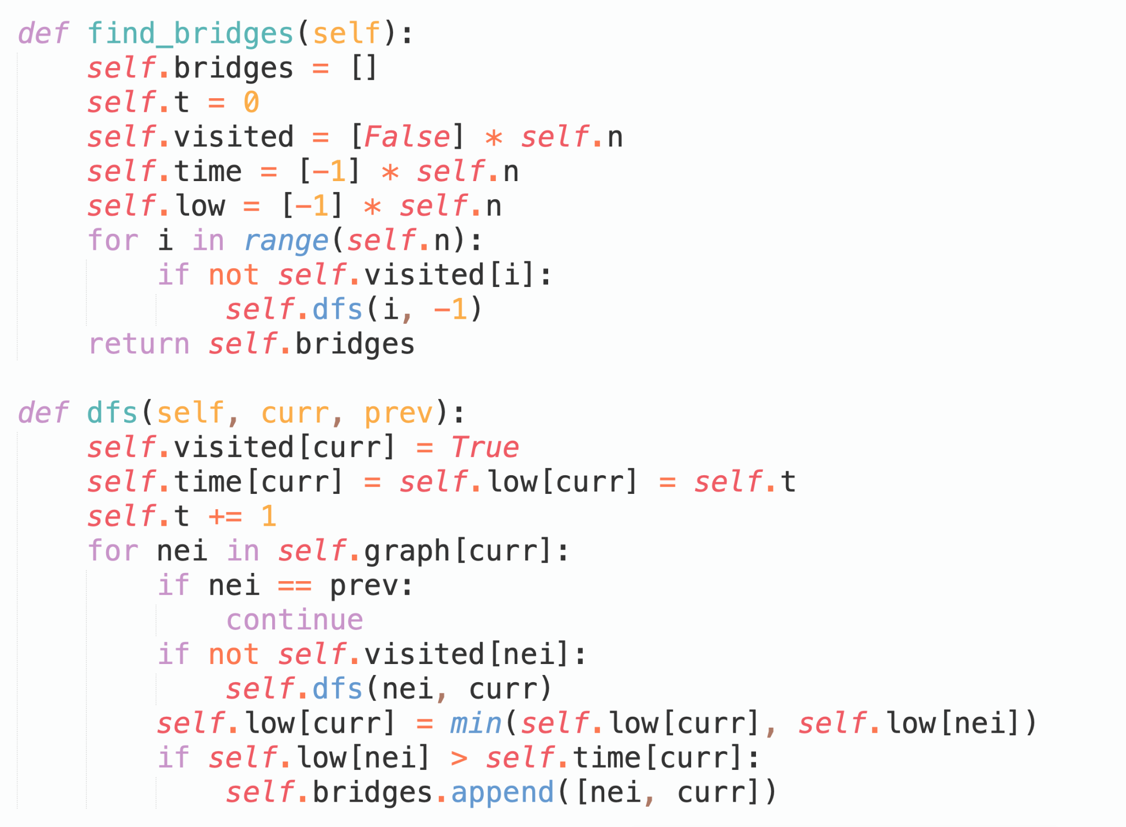
Solution 4: Bridges
Finding bridges in linear time O(V + E) is a well studied problem that utilizes the Tarjan’s algorithm based on DFS.
We adopted this method in our exploration.

Slide 19
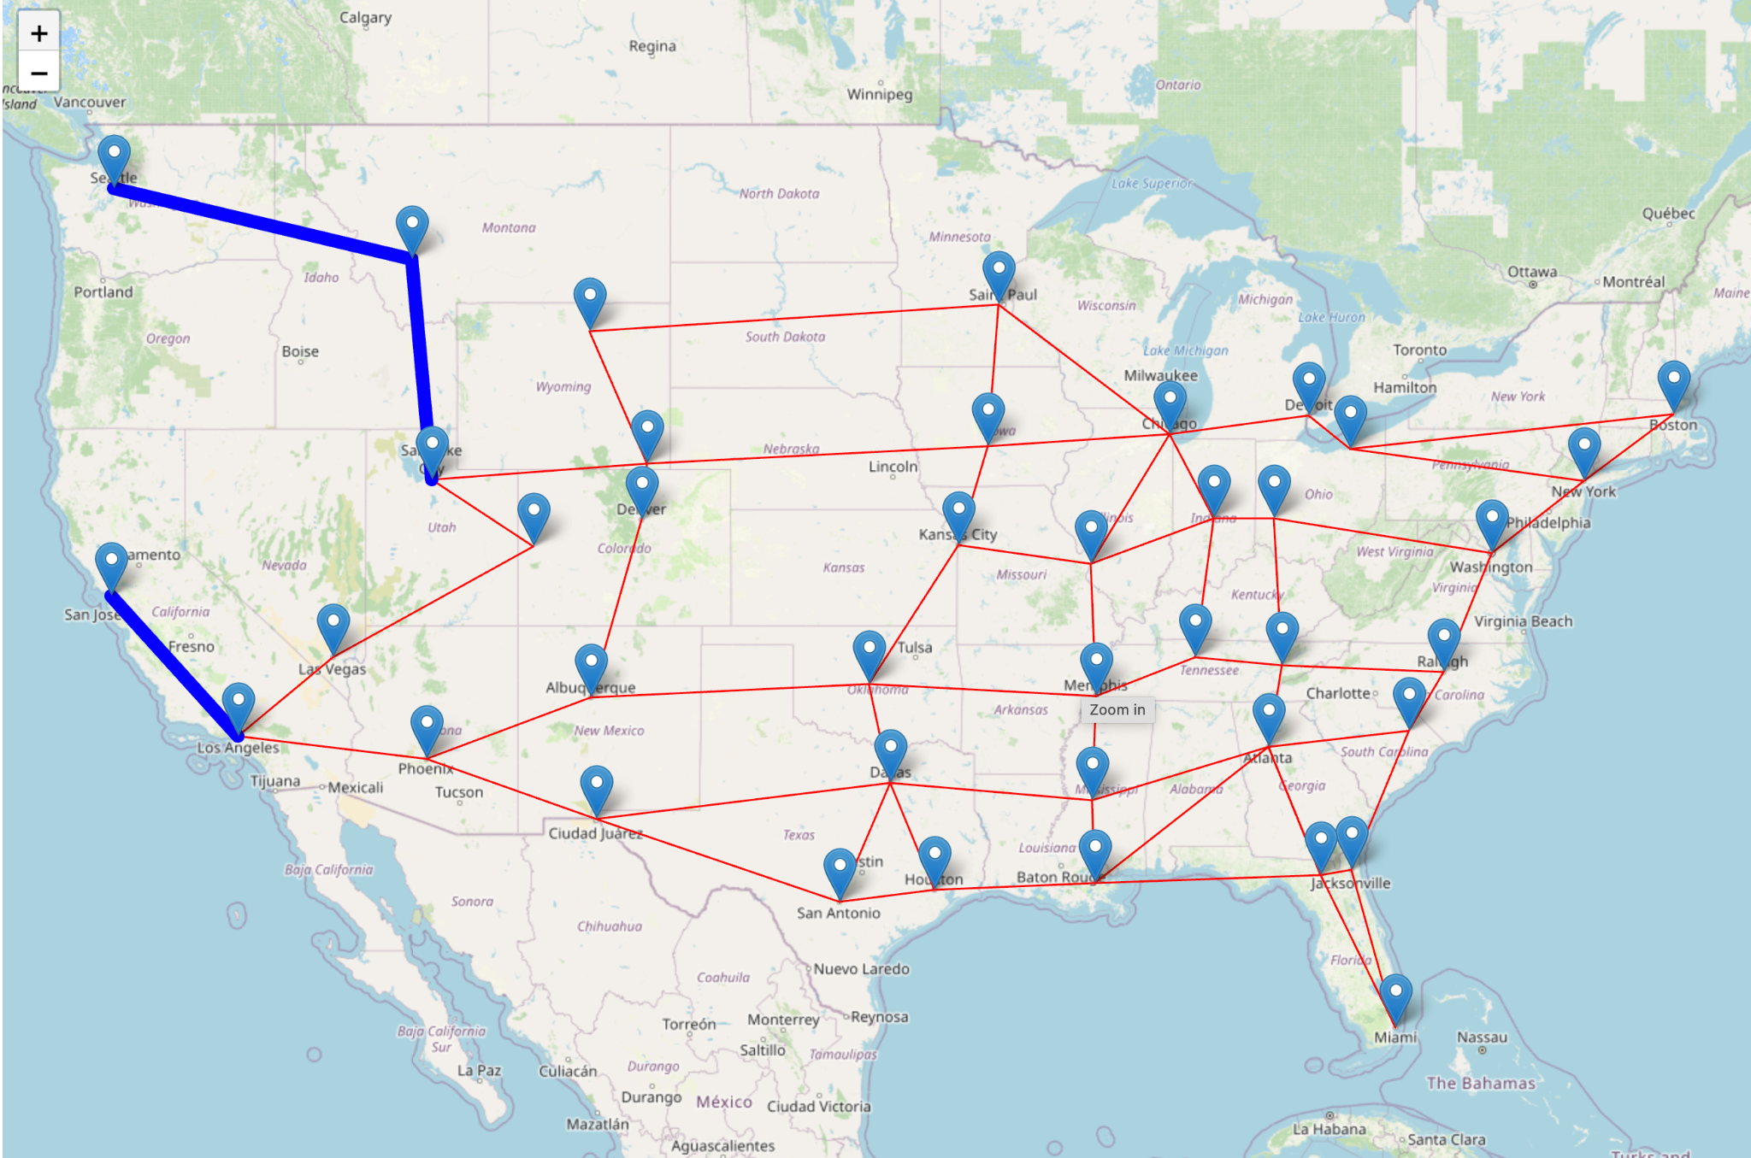
Example 4: Bridges
In year 1979, three freeways Seattle to Butte, Butte to Salt Lake City, and San Francisco to Los Angeles are detected as bridges.

Slide 20
Conclusion
In this project, we explore various properties in a dynamic graph with realistic US freeway data.
Although our dataset is relatively small in size, we provide theoretical analysis of time complexity, aiming for more efficient algorithms.
We also present tradeoffs in designing data structures and algorithms in an online setting.

Slide 21
References
Finding bridges in a graph in O(N+M) - Algorithms for Competitive Programming. (n.d.). Cp-Algorithms.com. https://cp-algorithms.com/graph/bridge-searching.html
Floyd–Warshall algorithm (2019, May 16). Wikipedia. https://en.wikipedia.org/wiki/Floyd%E2%80%93Warshall_algorithm

Slide 22
Thanks for your attention.
Questions?

Slide 23
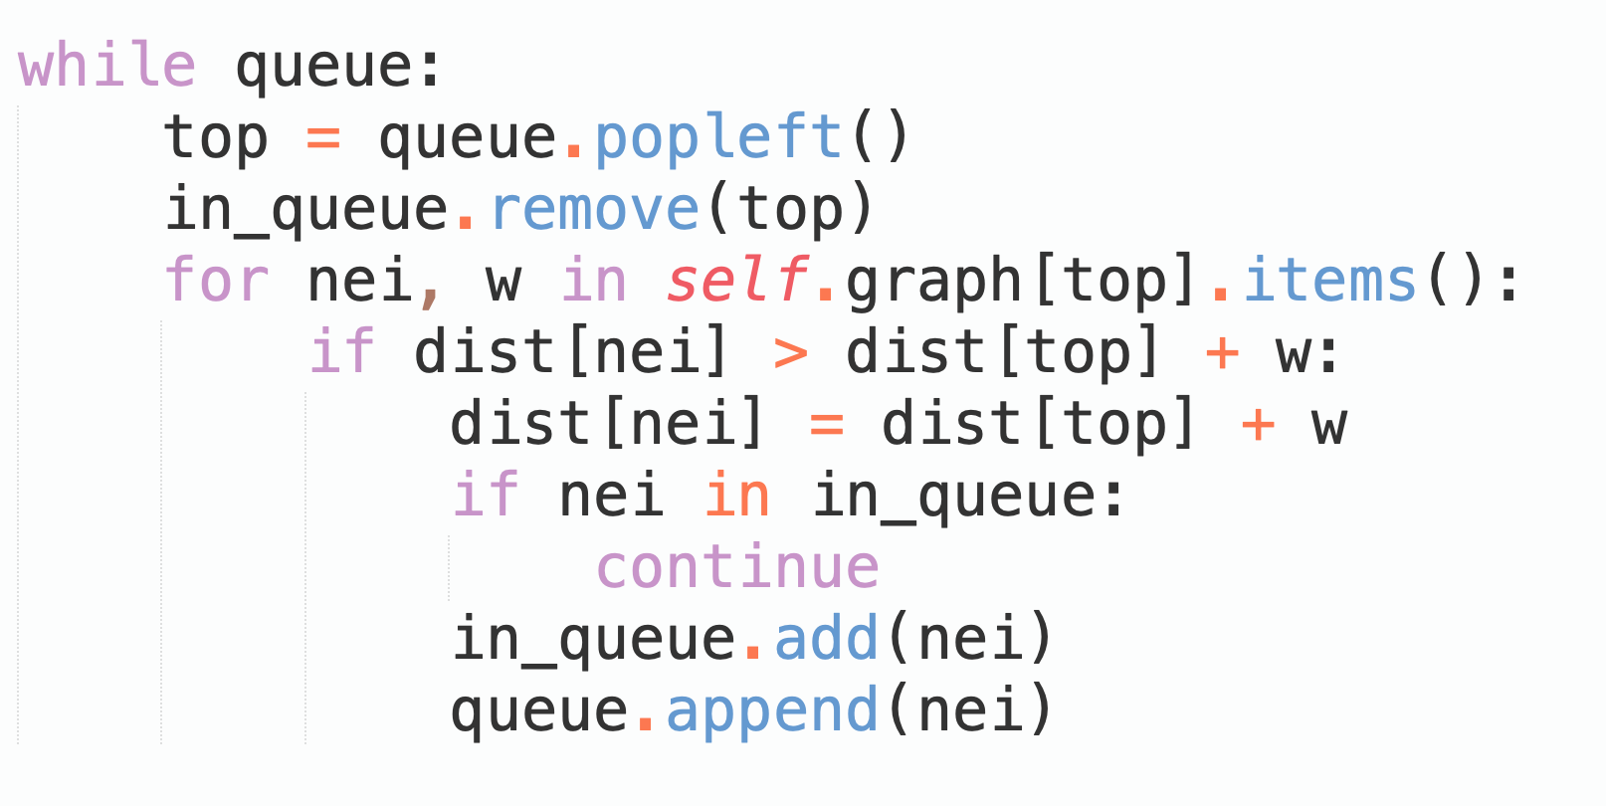
Solution 1.1: Single-Source Shortest Path
Find Shortest Distance
Alternatively, we can also use D’Esopo-Pape (Shortest Path Faster Algorithm, SPFA).
The algorithm keeps relaxing the edge while possible.
Simpler to implement compared with an indexed priority queue.
Worst Case: Ω(VE)

Slide 24
Problem 1: Update Graph and Find Shortest Distance
What if there are many queries but only a few updates?
For example, if we update graph once, with 1 million consequence queries of shortest distance?
Consider our highway network. One can assume that the updates to the graph only happen rarely.
Though Dijkstra is efficient but implementing it every time for shortest path query is costly therefore another approach is to calculate shortest distance for every pair, in which an Algorithm Floyd Warshall comes in handy.

Slide 25
Example 1
Shortest path faster algorithm. (2024, April 23). Wikipedia. https://en.wikipedia.org/wiki/Shortest_path_faster_algorithm#

